Slide 1
TOURIST PLACES IN INDIA
PROJECT SUBMIT BY:
NAME:K.JYOTHI
NAME: K.DINESH
name: R.SHANMUKHA RAO
NAME:A.HEMANTH KUMAR

Slide 2
INTRODUCTION AND OVERVIEW
Tourism In India
India is a country that attracts millions of tourists every year and is considered one of the most popular tourist destinations in the world. These visitors are attracted to its natural beauty and cultural heritage. It has many historic sites as well like the Taj Mahal, Golden Temple, Red Fort, etc. With so much to offer, it’s no surprise that tourism is one of the main sources of revenue for the country!
Tourism in India has been seen as a major tool to bring about socio-economic development to the people of the country. India’s tourism industry has grown steadily in recent years. Not only this, India Tourism industry also provides employment opportunities to several people from all parts of the world. There are ample numbers of hotels, resorts, food joints and various other amenities available for tourists arriving in India.
No wonder Tourism is an important foreign exchange earner for India. The Department of Tourism, Ministry of Civil Aviation, Government of India is the apex body for the largest development and promotion of Indian tourism. To promote tourism in India, the government has been implementing a number of campaigns and schemes. These include Incredible India campaign along with a number of planned events such as the International Travel Mart, Destination India Exhibitions worldwide and Indian Cultural Festivals Abroad to attract foreign tourists.

Slide 3
PURPOSE
Economic Growth: Tourism is a significant contributor to India's economy. It generates foreign exchange earnings, creates job opportunities, and stimulates various sectors such as hospitality, transportation, retail, and handicrafts. As tourists spend money on accommodation, food, souvenirs, and transportation, it boosts the overall economic growth of the country.
Cultural Exchange: India is a land of diverse cultures, traditions, and heritage. Tourism fosters cultural exchange as visitors from different parts of the world get to experience India's rich history, art, architecture, festivals, and traditions. This exchange enhances mutual understanding and appreciation between people of different backgrounds.
Preservation of Heritage Sites: India is home to numerous UNESCO World Heritage Sites, historical monuments, and ancient temples. Tourism plays a vital role in conserving and maintaining these sites by generating revenue that can be reinvested in their preservation and restoration. Additionally, increased tourism often leads to better infrastructure and facilities in these areas.
Promotion of Regional Development: Tourism can promote balanced regional development by attracting visitors to less-explored areas and remote regions. This helps in reducing the economic disparities between urban and rural areas, as well as encourages the growth of local businesses and community initiatives.

Slide 4
PROBLEM AND SOLUTION
PROBLEMS:
PROBLEM: Connecting the pages from one page to another page
PROBLEM: Creating a navigation bar
SOLUTION:
Learned from different websites and approached
Learned a bootstrap

Slide 5
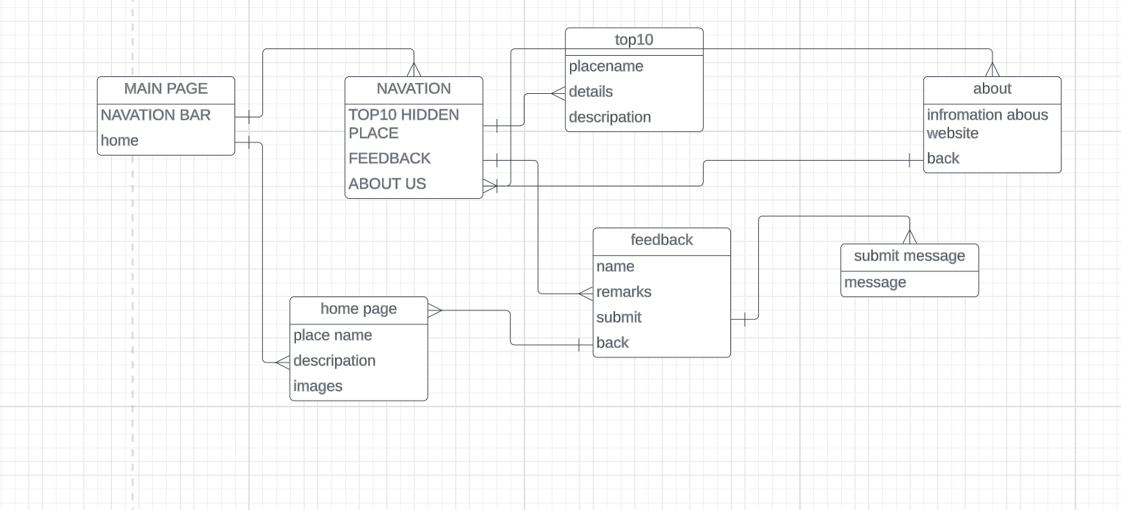
Block diagram

Slide 6
Hardware and software requirements
HARDWARE REQUIREMENTS: Laptop or computer and internet connection
SOFTWARE REQUIREMENTS: 1.Subline text or notepad
2.internet browser

Slide 7
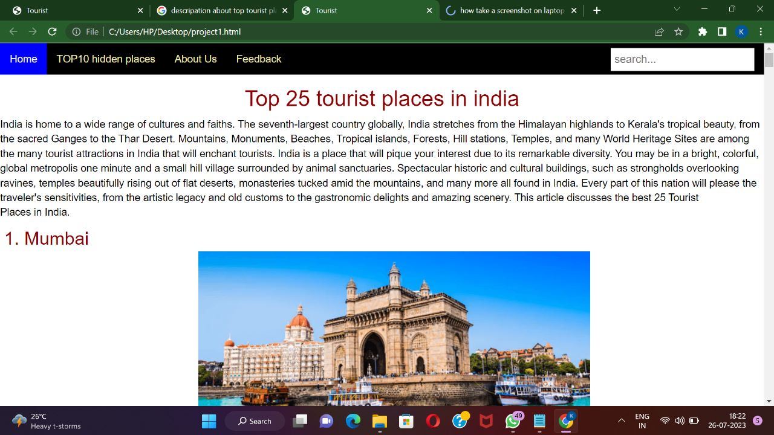
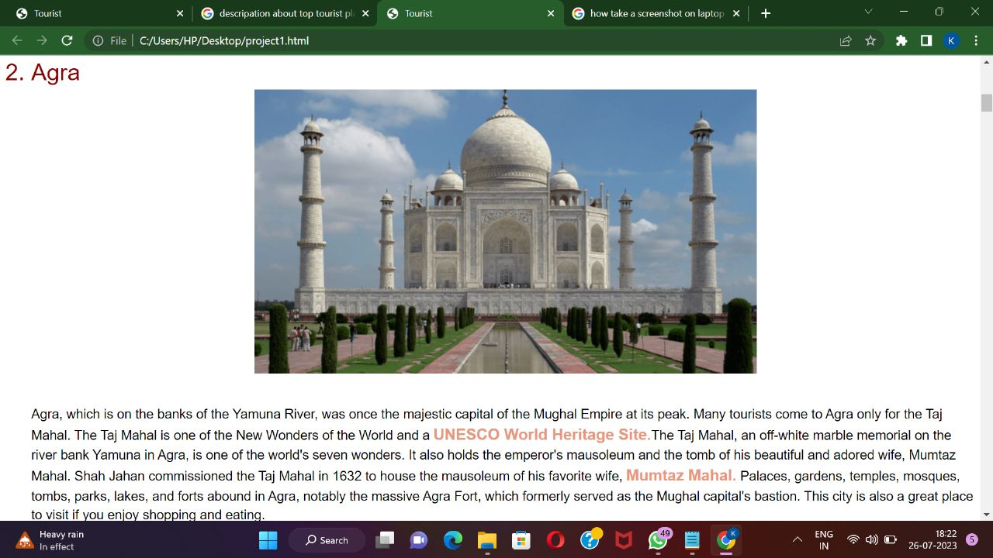
SCREENSHOTS AND OUTPUT

Slide 8
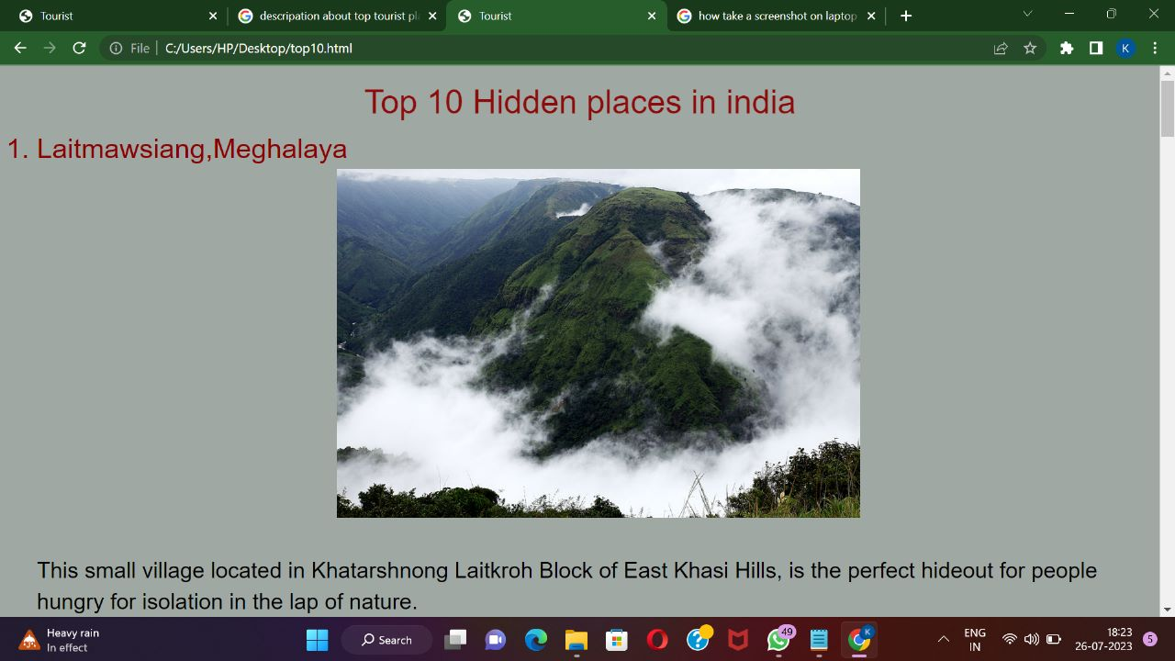
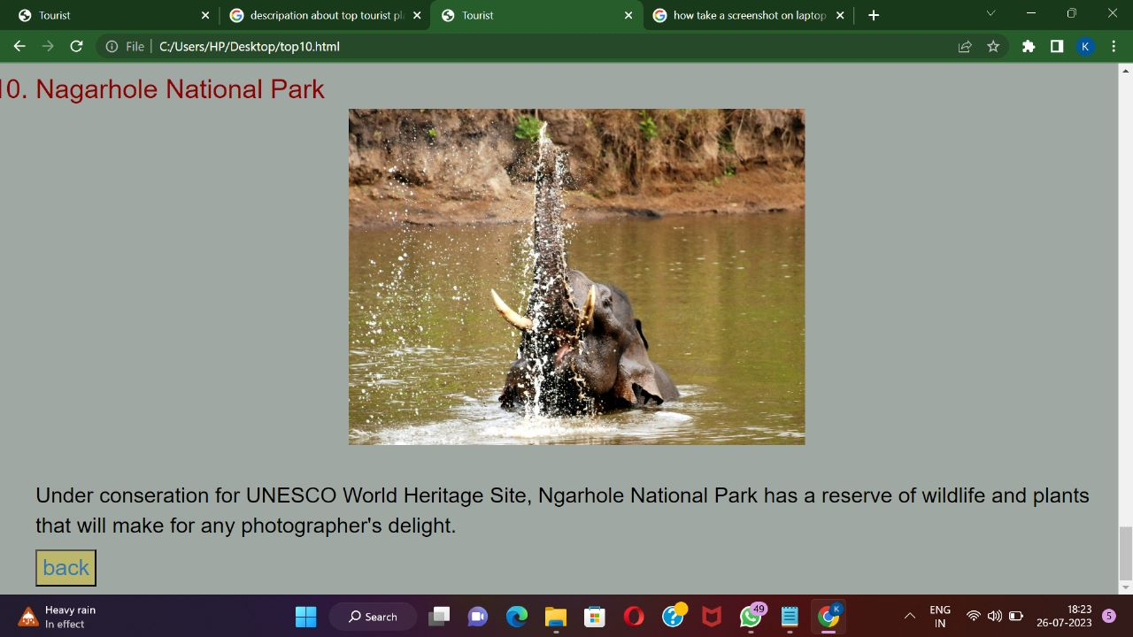
SCREENSHOTS AND OUTPUT

Slide 9
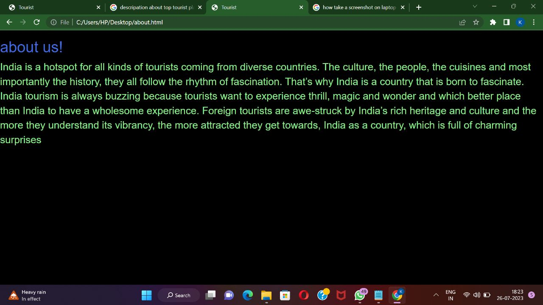

SCREENSHOTS AND OUTPUT

Slide 10
Advantages and disadvantages
Advantages of Tourism in India:
Economic Growth and Employment: Tourism is a significant contributor to India's economy, generating foreign exchange earnings and creating employment opportunities. The hospitality, transportation, and retail sectors thrive due to increased tourist spending, leading to economic growth in various regions.
Cultural Exchange and Global Awareness: India's diverse culture and rich heritage attract tourists from all over the world. Tourism fosters cultural exchange, promoting mutual understanding and appreciation among people of different backgrounds. It also enhances India's soft power by showcasing its traditions, arts, and spirituality on the global stage.

Slide 11
Advantages and disadvantages
Disadvantages of Tourism in India:
Environmental Impact: Mass tourism can put a strain on India's natural resources and ecosystems. Unplanned development, pollution, and waste generation in tourist hotspots can lead to environmental degradation, affecting delicate ecosystems, wildlife, and biodiversity.
Cultural and Social Concerns: While tourism can promote cultural exchange, it may also lead to cultural commodification and dilution of traditional practices. Some tourist activities may exploit local cultures for commercial gain, leading to a loss of authenticity and identity among local communities.

Slide 12
APPLICATION AND CONCULSION
some key application of tourism in India:
Development of Infrastructure: The tourism sector plays a pivotal role in the development of infrastructure in various regions of India. As tourist destinations become more popular, there is an increased demand for better transportation, accommodation, and recreational facilities. This drives investments in infrastructure development, benefiting both tourists and local residents.
CONCLUSION:
Tourism is a powerful and multifaceted industry that has significant impacts on economies, cultures, and environments worldwide, including India. As we have explored, tourism in India has both advantages and disadvantages. It is essential to strike a balance and approach tourism responsibly to maximize the benefits while mitigating the negative effects.

Slide 13
THANK YOU
ANY QUESTIONS ?

